Slide 1


ArcGIS Experience Builder: Building Your First Widget
Previn Wong and Alix Vezina
2023 ESRI USER CONFERENCE

Slide 2


Topics
Getting started: Experience Builder Developer Edition, React, and Typescript
Type of widget and Lifecycle of a widget
Demo creating a widget

Slide 3
React, Components, and Typescript
To build a custom widget, you will need to download ArcGIS Experience Builder Developer Edition and have Node JS installed.
React is a Javascript library for building user interfaces and components (buttons, list, panels, popovers, etc)
Experience Builder fully support and integrated with Typescript. All files are .ts and .tsx and needs to be built into regular .js files.

Slide 4
React, Components, and Typescript
JIMU-UI
JIMU-LAYOUTS
JIMU FOR BUILDER
JIMU-ARCGIS
Jimu-core
ARCGIS MAPS SDK for JAVASCRIPT
Widget Manager | Config Manager | DataSource Manager | Extension Manager | Message Manager
TypeScript
React
Redux
Webpack

Slide 5
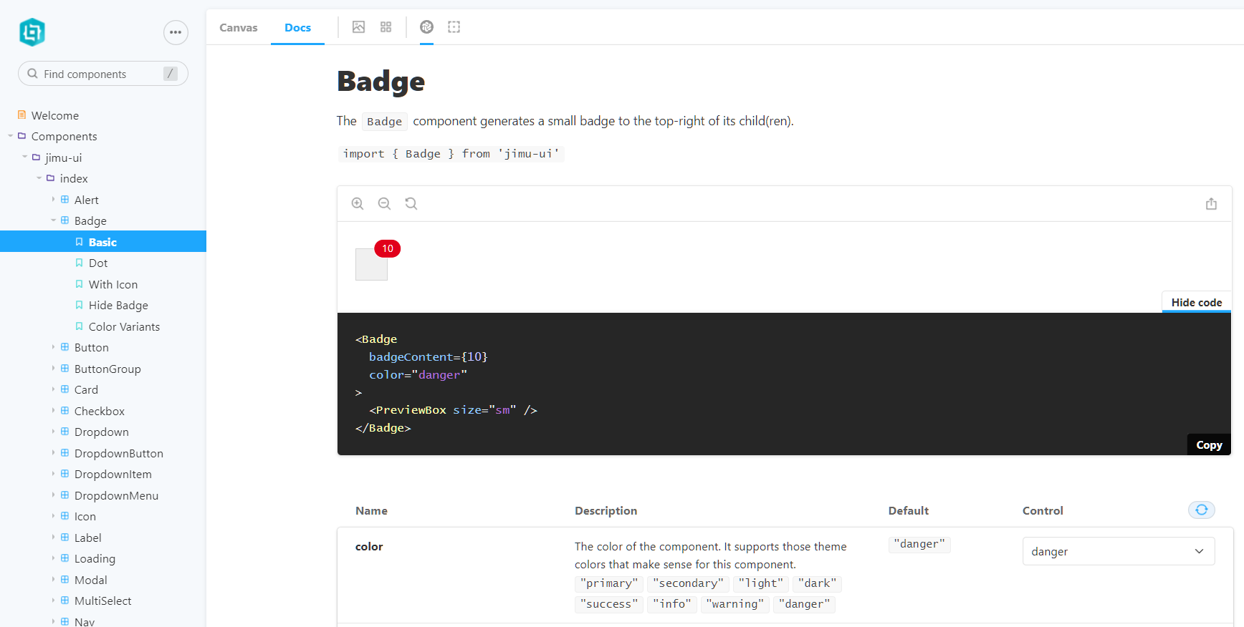
JIMU-UI Storybook
https://developers.arcgis.com/experience-builder/guide/storybook/

Slide 6
Type and Lifecycle of a Widget
Class components
Has a lifecycle workflow.
Can maintain its own data with state.
Passes props (properties) down to class components and access them with this.props.
Uses the render() method.
Function components
No lifecycle.
Can accept and use props.
Uses React Hooks to use state (optional).
There is no render() method, call UseEffect (optional).

Slide 7

DEMO

Slide 8
Deployment Methods
Export from Experience Builder Developer Edition
Complete standalone app
Must be served from a webserver
Load as a custom widget in ArcGIS Enterprise
MUST compile the widget to .js files
Place just the widget in a webserver
Webserver must be accessible to your ArcGIS Enterprise
Add item as an Extension in Enterprise

Slide 9


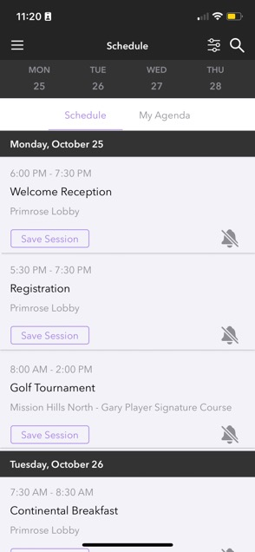
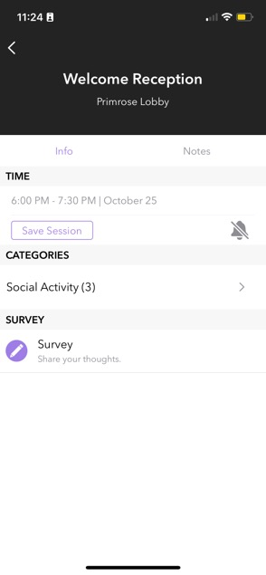
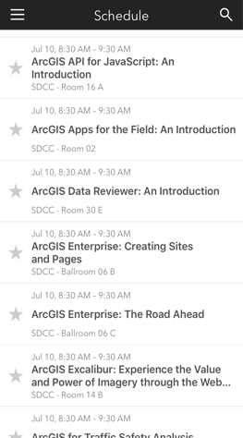

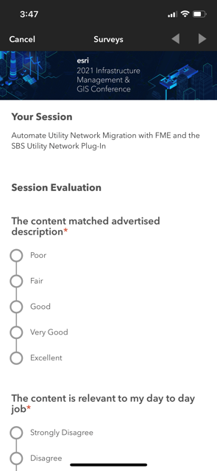
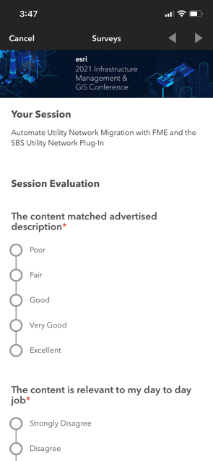

Please Share Your Feedback in the App
Please use the session survey if you have one of the following session types:
- Technical Workshops
- Expo Spotlight Talks
- Demo Theater Presentations
- SIGS
- Pre-conference Seminars
- User Presentations
Download the Esri Events app and find your event
Select the session you attended
Scroll down to “Survey”
Log in to access the survey

Slide 10


Copyright © 2023 Esri. All rights reserved.

